Slide 1

Metadata Enrichment from
Unstructured PDFs
using Modular RAG
~Ishan Tandon
Team member: Ishanika
Mentors: Saood and Denzil
Structured extraction · retrieval · benchmarking · enrichment

Slide 2
Table of Contents
01 Problem statement & motivation
02 Structured extraction: OCR → Chandra
03 Dataset analysis & validation attributes
04 Query design & variations
05 System architecture (modular RAG)
06 Chunking strategy & hyperparameters
07 Embedding models & comparison
08 Chunk vs Pages Comparison
09 Reranking & vector store
10 Future work

Slide 3
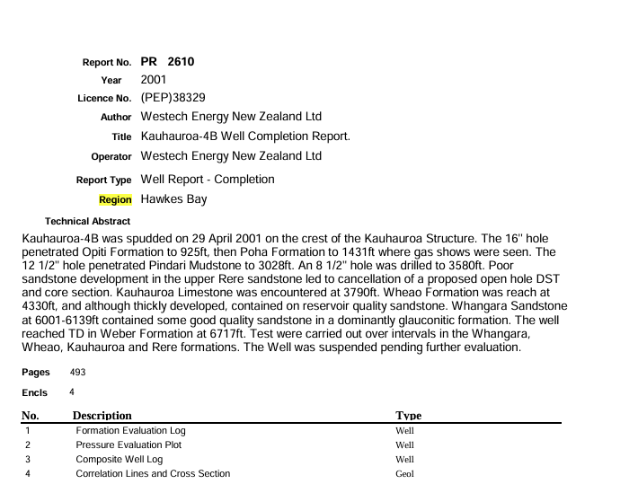
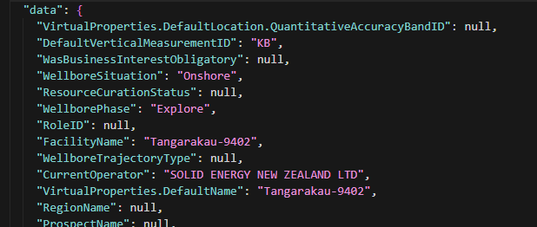
Problem Statement
Extracting reliable metadata from unstructured technical PDFs
Goal
– Build a pipeline that extracts the information from the unstructured data and fill the missing values back to structured json files.
Structured data
Unstructured data
Notes:
Goal: extract missing well/facility metadata from PDFs, validate against structured records, and benchmark each design choice.
Why it is hard
– No fixed schema – every report formats the same field differently
– Mixed content – narrative text, tables, figures and OCR noise
– Answers must be traceable to a source page for trust and audit
A lot of data , millions document i.e unstructured data, each fiule containg 500 to 5000 pages is the scale on which we will be working on , it’s a huge data . And correspondiong structured data with it, and each file have 100 of attributes , which are majorly missing
this is what our work comes which is too fill this large missing data from the enormous amount of data slb has collected over years in form of unstructured data.
For this a basic approach comes in mind why not give the whole pdf to ai and ask the answer to them , they are quite smart now.
Yah I agree they are smart , very smart but smartness doesn’t come free of cost
this takes us to our first slide which introduces to our method of tackling the problem using rag rather than using direct ai.

Slide 4
The Problem: why a naive OCR -> LLM approach fails
Motivation for a structured, measurable pipeline
Naive approach: OCR the PDF -> dump raw text into an LLM -> hope it extracts fields
  – No structure: headings, sections and tables are lost -> cannot target evidence
  – Noise: OCR errors and repeated headers/footers dilute the context
  – Cost & latency: sending whole documents to the LLM is expensive and slow
  – No traceability: answers cannot be tied back to a page / section
Conclusion: we need structured extraction + retrieval + evaluation
  – Retrieve the right evidence first, then let the LLM read a small, relevant context
Metric (per 1 PPT) | Naïve OCR→LLM (exhaustive page scan) | Structured pipeline (chunking+retrieval+LLM)
Total LLM calls | 475 (475 page scans) | 1
Total tokens | 361,799 | 25,809
End-to-end time (s) | 820.3223 s (~13.7 min) | 20.4882 s
Total cost ($) | $1.75396 | 0.14702
Accuracy | 75.0% | 50.0%
Notes:
This was just a small pdf , which is consuming almost 16x cost , comparative to my rag approach , this may extend to upto 200 times .
Now we move forward with rag , so first we need data , not unstructured data, but text extracted from those pdfs.For it we choosed datalab Chandra model.
What is this ! Lets c

Slide 5
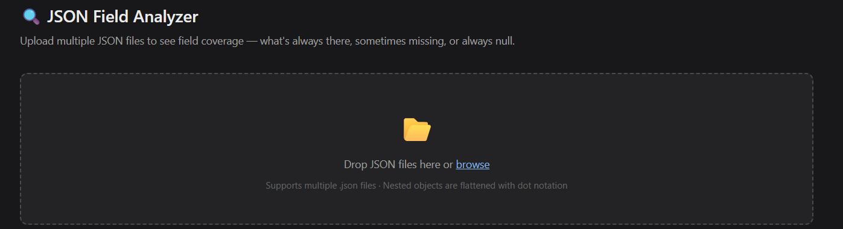
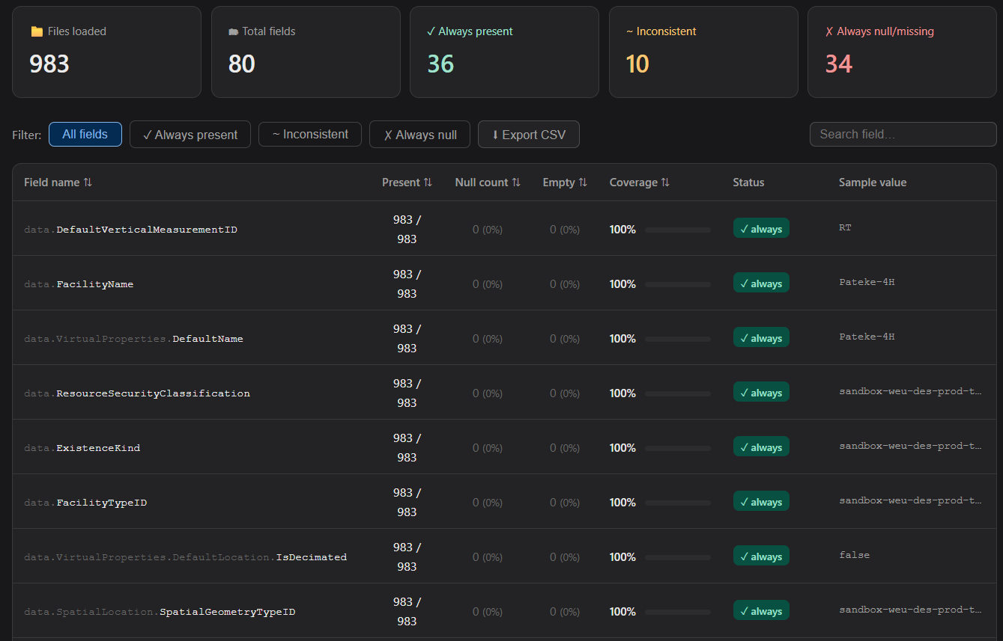
Dataset analysis -> choosing validation attributes
HTML analyzer to find what is present / partial / missing
Built an analyzer to profile the dataset across documents
  – Which fields are always present, partially present, or frequently missing
  – Missing-but-recoverable fields are the best enrichment candidates
Attributes validated :
Why this step matters
  – Prevents optimizing for trivial or random fields
  – Ensures the benchmark reflects real missingness
  – Extra analyzer candidates (coordinate type, region, vertical depth) are future additions
Facility name
Operating environment (onshore / offshore)
Spud date
Latitude / Longitude
Notes:
These 4 labels map 1:1 to rag_evaluation.GROUND_TRUTH_EXTRACTORS and queries.txt.
Now we have data , and also the structured data, and queries : now we are ready to go with the processing/method we want to follow to get the missing values in the structured data.we designes the architechtire.

Slide 6
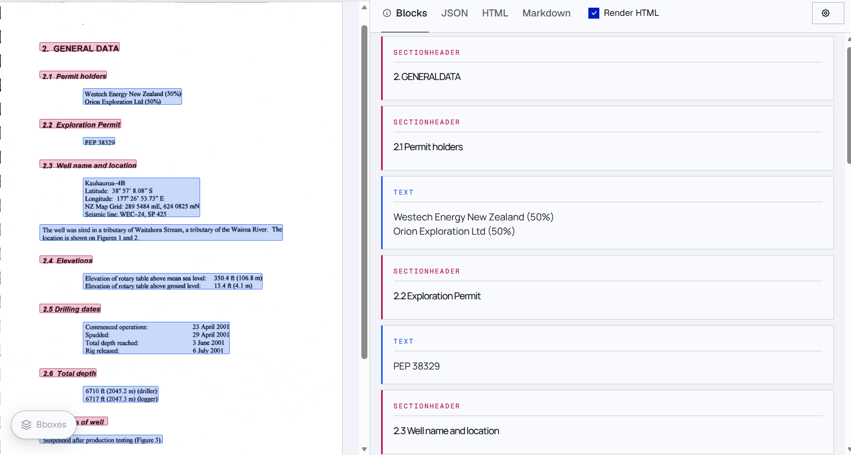
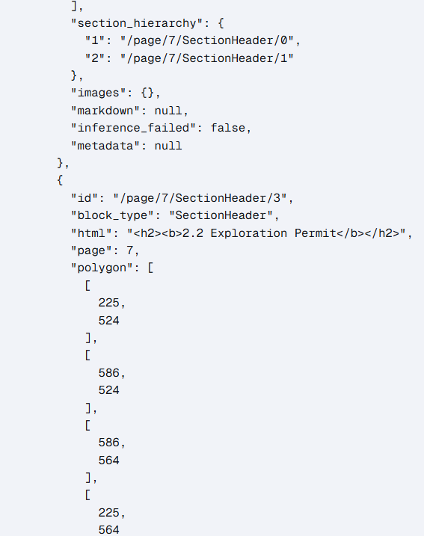
Extraction upgrade: OCR -> Chandra (Datalab)
• Chandra returns a page-wise JSON tree with section tags, geometry boxes and HTML text
  – Enables section-aware chunking, page-aware context and table signals
Notes:
Problem with plain OCR (left/top row)
“With plain OCR, we essentially get a noisy wall of text. It breaks tables, loses section boundaries, and produces inconsistent chunks—so retrieval becomes hit-or-miss because the ‘units’ we search over aren’t meaningful.”
What Chandra changes (bottom row)
“Chandra gives us a page-wise JSON tree with section tags, geometry/bounding boxes, and HTML-like structure—especially for tables. That structure is the key difference.”
Why structure matters for RAG (the ‘so what’)
“Because we now know what a chunk is (section/table/caption) and where it came from (page and coordinates), we can do section-aware chunking, preserve table semantics, and retrieve the right evidence instead of guessing.”
Business value (meeting-ready bullets)
“Higher quality retrieval units → fewer misses and less hallucination risk.”
“Traceability improves: we can point back to the exact page/section/table.”
This data can be used by the company in building other products later on, as it is a high quality data good for chatbots type things.So its one time investment.
We figured to handle unstructures data, now comes the part to work on structured data.Which fields are missing .

Slide 7
Query variations: why three styles
Documents phrase the same fact in many ways
1. Direct
"What is X?"
2. + Description
adds domain meaning
3. + Metadata / synonyms
expected alternative terms
• Why: retrieval improves when the query contains vocabulary the document actually uses
  – Pros: higher recall for paraphrased / domain-specific phrasing
  – Cons: longer queries can pull irrelevant content -> keyword choice matters
Notes:
Query enrichment is a cheap lever before touching models.

Slide 8
System Architecture
Modular design - each stage is an isolated, swappable file
Indexing Pipeline
Extraction
JSON
Loader
Merging
Chunking
Embeddings
FAISS
store
Inference Pipeline
Query
Embed
Retrieve
Rerank
Context
LLM
Validate
main.py + config.py — single entry point, ALL hyperparameters & component toggles
• Swap any component (embedding, reranker, LLM, vector DB, prompt) by editing one file or one config flag
  – Defaults: TF-IDF embeddings, dense retrieval, reranker off, chunk context (each is an ablation knob)
Notes:
Reproducibility: config toggles reproduce every variant for clean ablations.
This Is a basic rag naïve approach which act as a backbone in our project, what makes it special in our project is the modularity which we implemented which allow us to make our approach updates with just a change in one file.

Slide 9
From Chandra blocks to retrieval chunks
Two methods — kept for ablation
Method 1 (baseline): convert Chandra blocks directly into chunks
  – Pros: simple, fast, minimal processing
  – Cons: too granular / fragmented; context is split; retrieval quality drops
Method 2 (current): flatten -> merge by section/page -> chunk long text
  – Pros: coherent retrieval units; better evidence aggregation
  – Cons: needs tuning; wrong merge rules can over-merge
Retrieval comparison (not much accurate right now)
Method | Retrieval acc. | Notes
Method 1 | 50% | 18k token used
Method 2 | 50% | 23k token used
Notes:
Keeping both methods is deliberate, to quantify the benefit of merging.

Slide 10
Chunking Hyperparameters
Sliding-window chunking + parameter sweep across 10 documents
Chunking sweep – averaged across 10 documents (recommended row highlighted)
chunk_size | overlap | Avg accuracy | Avg time (s)
1200 | 100 | 53.9% | 50.38
800 | 200 | 53.9% | 52.50
800 | 100 | 51.1% | 49.03
800 | 400 | 51.1% | 49.11
1200 | 0 | 48.3% | 48.01
800 | 0 | 48.3% | 48.86
1200 | 200 | 48.3% | 53.83
400 | 100 | 47.5% | 46.79
1200 | 400 | 45.6% | 47.55
400 | 200 | 45.6% | 47.77
400 | 0 | 45.0% | 45.36
200 | 100 | 45.0% | 46.03
200 | 0 | 40.0% | 47.23
Why tune chunking?
– Baseline RAG (OpenAI embeddings, no tuning) reached only 40% accuracy
– Swept chunk_size × overlap, averaging LLM accuracy across 10 documents
Recommended: chunk_size 800 / overlap 200
– Ties for the highest accuracy (53.9%) and is the most robust per-doc winner
– Overlap → stable retrieval, fewer missed facts at chunk borders
– Trade-off: overlap increases index size & embedding cost
Notes:
Word-based windows; overlap is the main lever against boundary loss.
On figuring out we saw, we were taking overlap as 0, which was creating a problem, if chunks breaks in between its context is lost for the next chunk so overlap was needed.
We fine tuned this and saw a great improvement

Slide 11
Embedding models: TF-IDF vs Jina v3 vs OpenAI
Retrieval quality is dominated by the embedding
Model | Pros | Cons | Verdict
TF-IDF | Offline, fast, cheap | Lexical only; misses semantics | Weak baseline
Jina v3 | Strong semantics; late chunking; better context | Heavy deps & compute; slow to load | Best in test, heavy
OpenAI | Best practical semantic quality; simple to use | API cost; external dependency | Good
• TF-IDF captured almost nothing semantic; Jina strong but heavy; OpenAI felt best overall
• All three are selectable in code (embedding_model = tfidf | jina | openai); stored in a FAISS DB
Notes:
In the naïve approach we were using tfidf which was too bad, we improved our embedding models, and the results were astonishing .
We analysed the retrieved chunks we saw the chunks retrieved were not even cloase to actual answer, we deduced that the quality of the chunks was low , so we experimented with different models.

Slide 12
Embedding models: measured results (TF-IDF vs Jina v3 vs OpenAI)
Model | Accuracy | Peak mem (MB) | Avg time/doc (s) | Cost per doc
TF-IDF | 40.5% | 3,672 | 16.9 | 0
OpenAI(text-embedding-3-small) | 52.7% | 1,424 | 65.0 | $0.247
Jina v3 | 59.3% | 1,354 | 218.4 | 0
• TF-IDF: lowest accuracy on every metric and heaviest memory (3,672 MB) → weak baseline.
• Jina v3:Ran on gpu, hosted the model locally, best accuracy %, but slowest (218 s/doc) → strong but heavy.
• OpenAI: low memory, moderate speed; API cost is causing the highest cost.
Notes:
After this we are storing the embeddings into faiss database so that once made the embeddings can be reused

Slide 13
Pages vs Chunks: full-page retrieval lifts accuracy
Same pipeline, no reranker – sliding-window chunks vs whole-page retrieval
Embedding model | CHUNKS |  | PAGES
 | LLM acc | Cost ($) | LLM acc | Cost ($)
TF-IDF | 40.5% | $0.079 | 53.7% | $0.106
OpenAI | 52.7% | $0.247 | 60.8% | $0.311
Jina v3 | 59.3% | $0.074 | 68.0% | $0.087
Whole-page retrieval beats chunking on accuracy across every embedding model
– TF-IDF: 40.5% → 52.7% (+12.2 pts)
– OpenAI: 52.7% → 60.8% (+8.1 pts)
– Jina v3 (pages): 68.0% – best overall
Cost trade-off
– Pages send more context to the LLM, so OpenAI / TF-IDF cost rises (~$0.07 → $0.11–$0.12)
– Jina v3 pages stay cheap ($0.074) – highest accuracy at the lowest page cost

Slide 14
Reranker: cross-encoder re-scoring before the LLM
cross-encoder/ms-marco-MiniLM-L-6-v2 — re-orders the top-25 dense/hybrid hits as (query, passage) pairs and keeps the best 10 sent to the LLM
Model | Accuracy— no reranker | Accuracy— + reranker | Δ
TF-IDF | 53.7% | 56.1% | +3.4
Jina v3 | 68.0% | 63.2% | -4.8*
OpenAI | 60.8% | 64.2% | +3.4
Why a reranker / pros
• Tiny & local (MiniLM-L-6, ~22M params, CPU-friendly); no API cost.
• Lifts the weaker retrievers mostly
• Tunable:easy to swap for a bigger cross-encoder (e.g. JINA reranker, BGE-reranker) or an LLM reranker.
• Trade-off: adds a forward pass per candidate (latency); negligible here since only 25 pairs are scored.
Notes:
Cross-encoder reads query + passage together → sharper relevance than bi-encoder cosine

Slide 15
Future work
Known gaps and next steps
• Better use of Chandra structure — exploit subsections, tables and geometry (currently under-utilized)
• Table-aware retrieval — tables dilute embeddings today; need a structured, table-aware representation
  • Row/column serialization with cell-level retrieval instead of one flattened block
• Retrieval upgrades — benchmark BM25 vs dense vs hybrid
• Prompt engineering — ask attributes in a fixed order; constrained, agentic extraction
• Systematic ablation — best embedding model, chunking strategy
• Expand evaluation harness — add remaining analyzer attributes (coordinate type, region, vertical depth)
Notes:
We started the project with basic knowledge of the system, in chaos
First week we figured out the problem statement clarity
Second week we were determined to develop a naïve approach for this problem statement , thinking of several approaches, brain stroming with my teammate Ishanika and our mentors was the most fun part .
Third week came with problems, which arised dusing implementation and figuring out the way , to make the results a bit better and trying various approaches, researching a bit , leading us to the mid term eval.
This flow and clarity in mind set while approaching such a major task and collaborating on black board , writing ideas, rejecting them , applying them, drinking coffee is what I learned till now from this.

Slide 16
THANK YOU

Slide 17
Jina embeddings v3: late chunking (why it helps retrieval)
Early chunking (traditional RAG)
Late chunking (Jina v3 concept)
Document pages
Document pages
Chunk first
(800 tokens, overlap 200)
Encode once at token-level
(long context)
Embed each chunk
(retrieval.passage)
Late chunking
pool token spans into chunks
Vector index stores chunk vectors
Vector index stores chunk vectors
(from same token space)
Why late chunking helps: embeddings are computed on the full sequence first, then pooled per chunk → less boundary loss, better table/field continuity, and more consistent chunk vectors.

Slide 18
Vector store: FAISS
Fast, local, reproducible similarity search
Why FAISS
  – Fast local nearest-neighbour search over dense embeddings
  – Simple to deploy; quick to rebuild for repeated ablations
  – Persisted as index.faiss + meta.pkl (vectors + chunks/metadata/BM25)
Limitations
  – No native metadata filtering -> section/page filters applied in Python
  – Hybrid retrieval needs a separate BM25 index alongside the dense index
Notes:
FAISS chosen for iteration speed; a managed DB can drop in behind the same interface.

